Slide 1

Notes:
We have performed binary and multiclass classification with scikit-learn. We'll now use the TensorFlow toolkit to create a deep neural network that can perform classification.

Slide 2
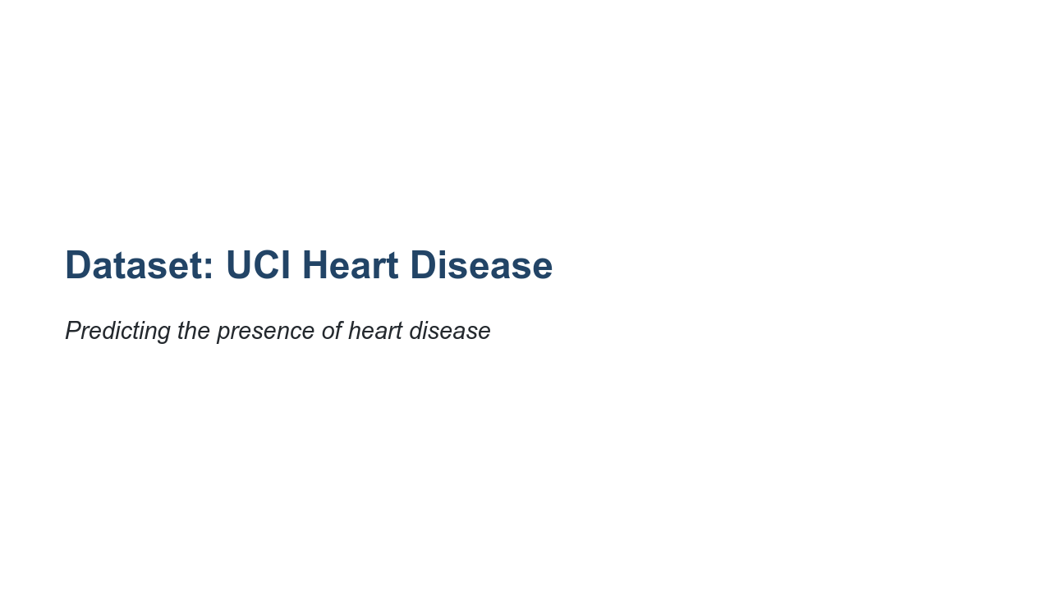
Notes:
The dataset that we'll use is the UCI Heart Disease dataset. The dataset contains health information about patients, as well as a "presence of heart disease" indicator. This indicator is a 1 for "has heart disease" and 0 for "does not have heart disease." As you can probably guess, the model that we will build will be a binary classification model.

Slide 3
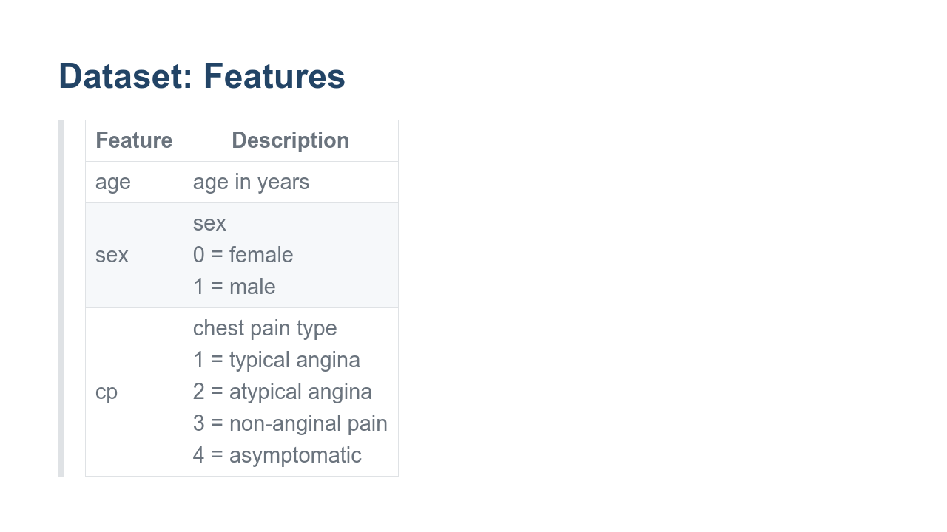
Notes:
The dataset contains 13 features. 'age' is an integer value representing the patient's age in years. 'sex' is a categorical column with zero representing female and one representing male. 'cp' stands for chest pain. It is a categorical column with the four values shown.

Slide 4
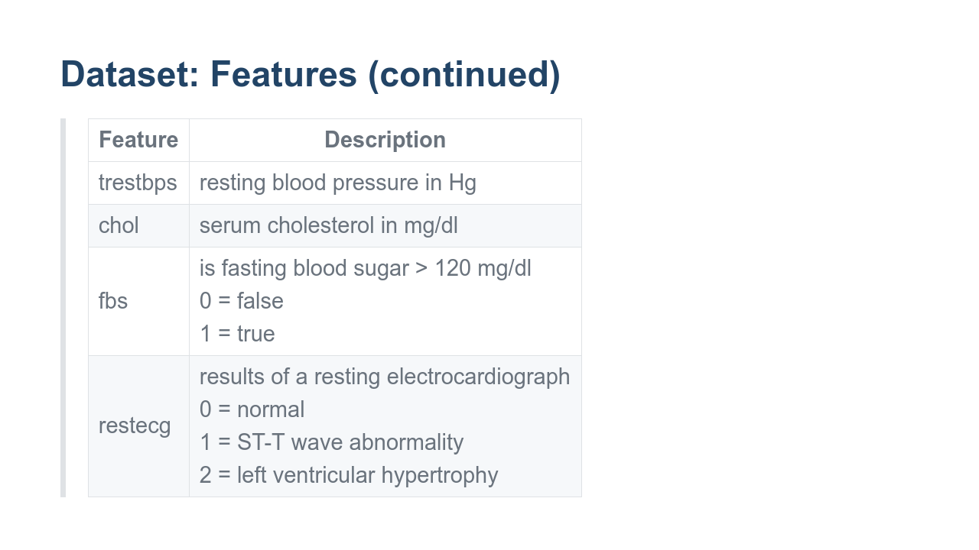
Notes:
'trestbps' is the resting blood pressure of the patient upon admission to the hospital. 'chol' is a variable representing cholesterol. 'fbs' is a measure of fasting blood sugar, but it is represented as a categorical column that measures if blood sugar is over a threshold. 'restecg' is a categorical column with the three values shown.

Slide 5
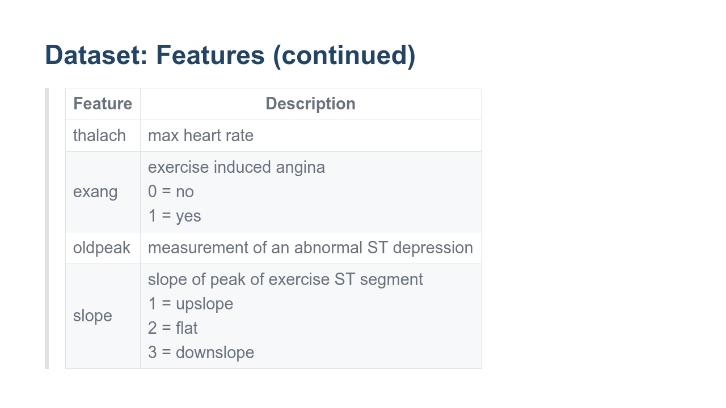
Notes:
The next two columns have to do with an exercise stress test the patients completed. 'thalach' is the maximum heart rate the patient achieved during the exercise session. 'exang' is a categorical variable that lets us know if the exercise caused angina. 'oldpeak' is a variable that measures ST depression. ST depression is a curve on an electrocardiogram graph where the ST segment line is very low when compared to a baseline. 'slope' is a strange one. Intuitively you'd expect it to be the slope of a line, but instead it is a categorical variable that lets you know which direction the line was going at the peak exercise ST segment.

Slide 6
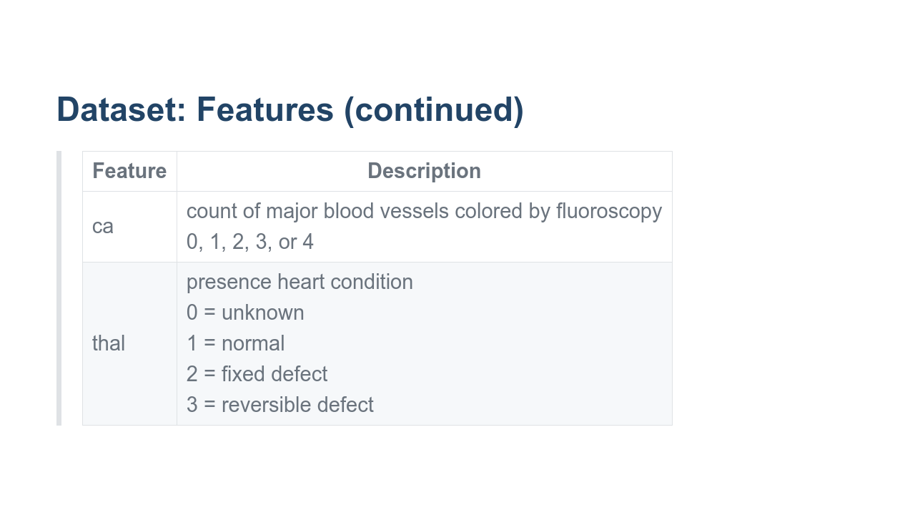
Notes:
'ca' is a count of major blood vessels colored by fluoroscopy. The values are 0, 1, 2, or 3 and are limited by biology. 'thal' relates to a heart defect. The column answers the following two questions. Does it exist? Is it repairable? You might notice the values on the slides for some of these columns differ from the documentation. For instance, the documentation for 'ca' states that the values range from 0-3, but there are 4s in the data. And the documentation for 'thal' says that the values are 3, 6, and 7, but the actual values in the data are 0, 1, 2, and 3. The takeaway from this is that you should always read the documentation, but you should also always look at the data and verify that the documentation is accurate. When there are questions, you should do research. If you are in contact with the source of the data, ask for clarification. Though documentation is great and can really help in data science, the dataset itself is the actual ground truth.

Slide 7
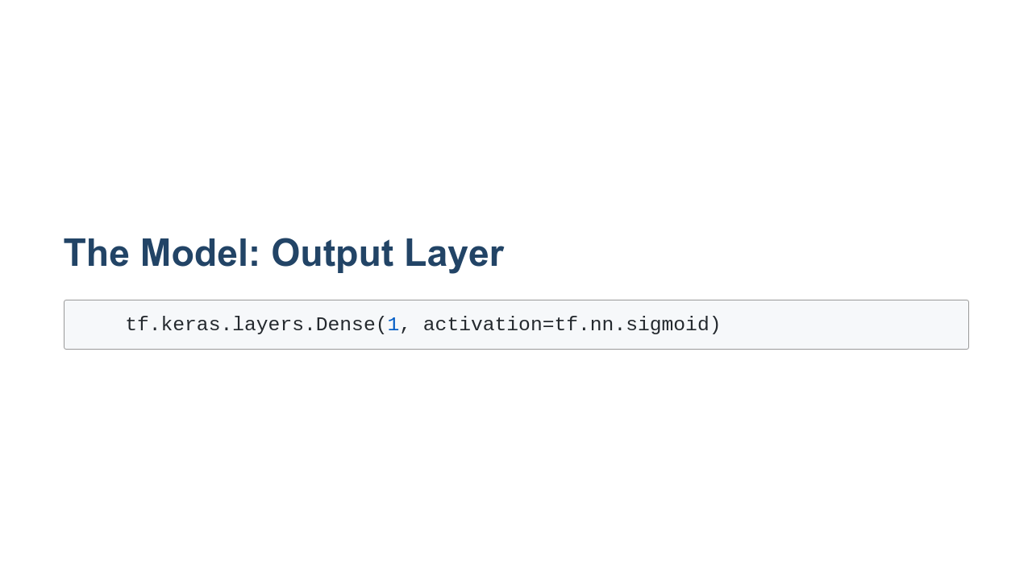
Notes:
The model in this lab won't look too different from the TensorFlow Keras models we built for regression analysis. The primary difference is the final layer in the model. We want to create a binary prediction that will let us know if a patient has heart disease or not. If we stick with the relu activation function for the output, then there is no bound for the maximum output value, so it would be impossible to understand what the prediction confidence is. Instead, we'll use an activation function that limits the output value. In this particular lab, we use a sigmoid function, so the output is limited to the range of 0.0 to 1.0. The output is then a measure of confidence that a patient has heart disease (since has heart disease is the 1.0 value). We can then decide how much confidence it takes to classify the patient as having heart disease. The choice of threshold is very important for model performance, and remember that we can measure performance at different thresholds with an RoC curve.

Slide 8
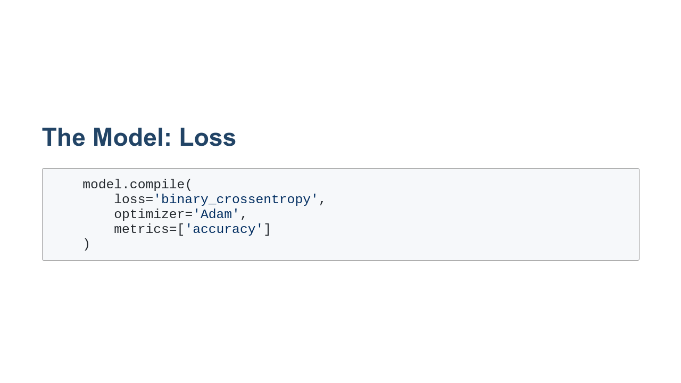
Notes:
How we measure loss is also very important. For binary classification problems, we need to use binary cross-entropy. Although we've talked a lot about using gradient descent for optimization, there are other methods as well. Adam is one of these methods. Adam uses an adaptive learning rate. That is, it uses a different learning rate for each of the different parameters in the model. This differs from stochastic gradient descent which uses a single learning rate for all parameters. A lot of research is being done to understand the conditions under which different optimizers perform better.

Slide 9
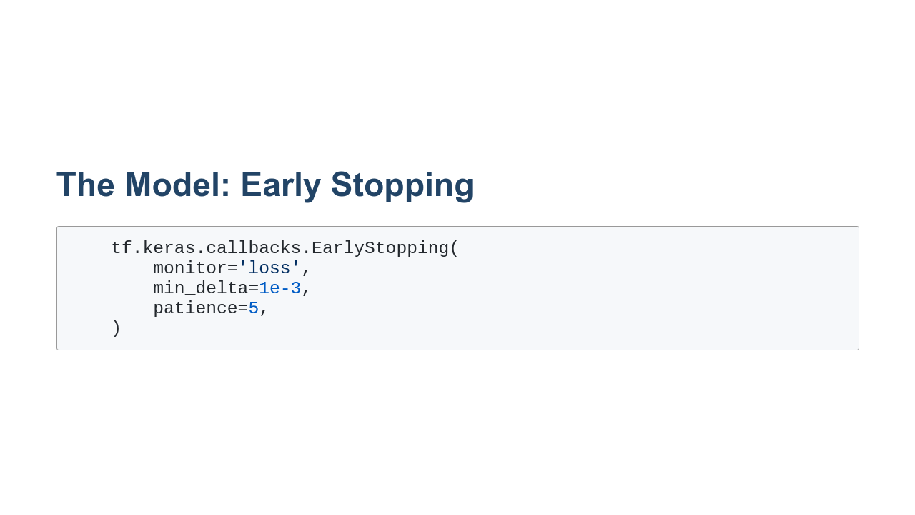
Notes:
We'll also visit early stopping in this lab. Early stopping is a model-fitting strategy where you monitor some metric - say, loss - and stop training when that metric doesn't change enough across a number of epochs. In this example we monitor loss and stop early if the loss hasn't changed at least 0.001 during any of the last five epochs.

Slide 10

Notes:
And with that, it is your turn to perform binary classification using TensorFlow Keras and deep neural networks.

